Slide 1
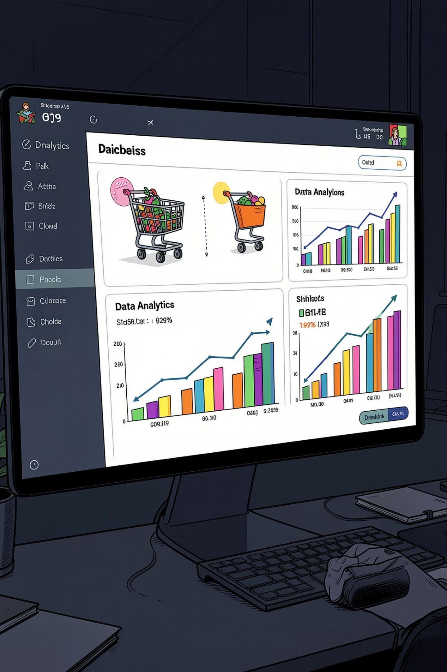
Customer Shopping Behavior Analysis
Uncovering spending patterns, customer segments, and product preferences from 3,900 transactions to guide strategic business decisions.

Slide 2

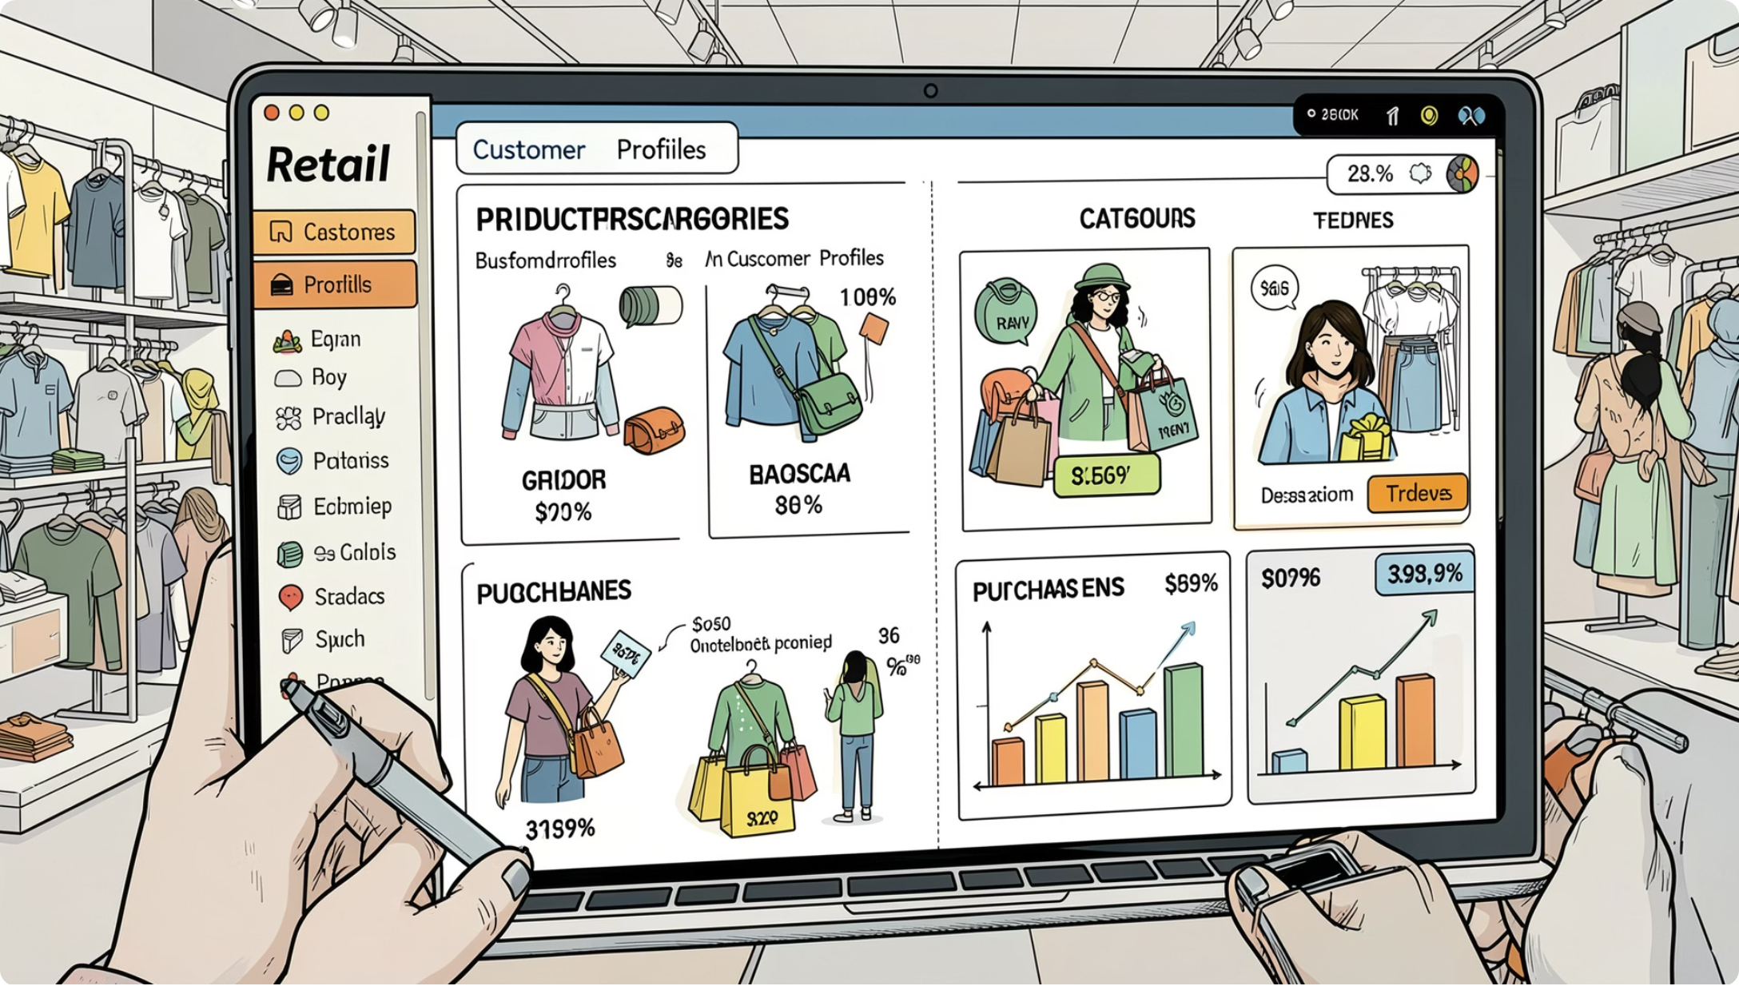

Project Overview
Dataset
3,900 purchases · 18 columns
Goal
Spending patterns, segments, product preferences & subscription behavior
Tools
Python · SQL · PowerBI

Slide 3
Dataset Summary
Demographics
Purchase Details
Age, gender, location, subscription status
Item, category, amount, season, size, color
Shopping Behavior
Data Quality
Discount, frequency, review rating, shipping type
37 missing values in Review Rating column

Slide 4

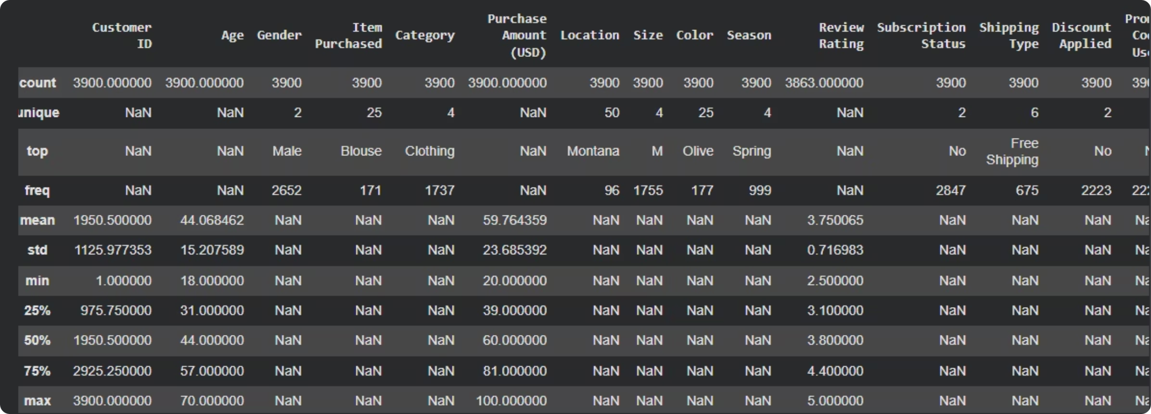
Data Preparation in Python
Load & Explore
Pandas: df.info() & .describe()
Clean
Imputed missing ratings by category median; standardized column names
Engineer
Created age_group & purchase_frequency_days; dropped redundant promo_code_used
Load
Connected to BigQuery; uploaded clean dataframe for SQL analysis

Slide 5
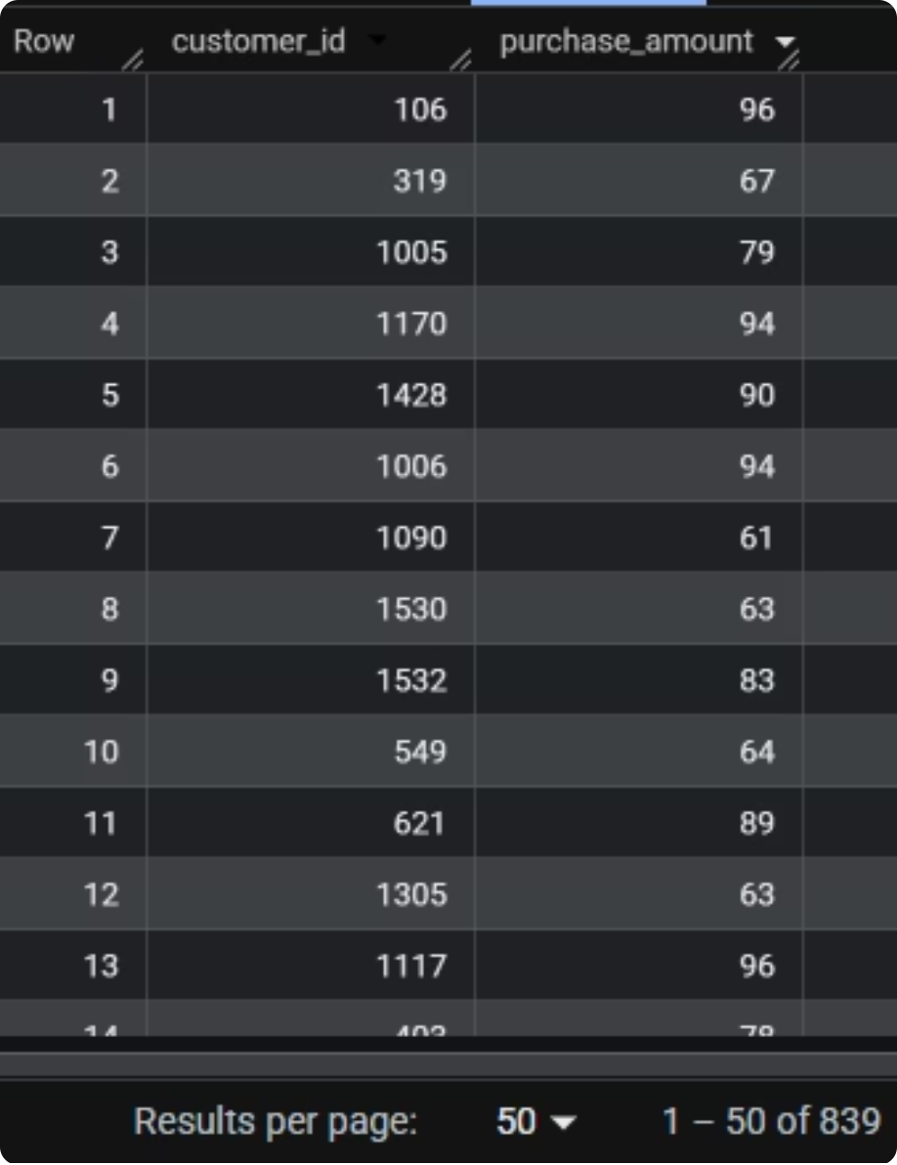
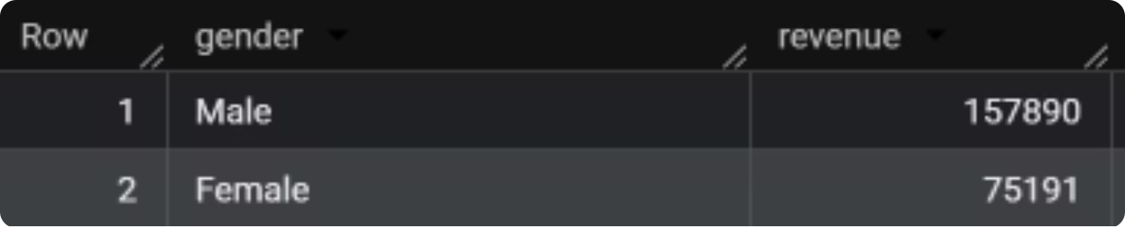
SQL Analysis: Revenue & Discounts
High-Spending Discount Users
Revenue by Gender
Compared total revenue by gender and identified discount users who spent above average purchase amount.

Slide 6
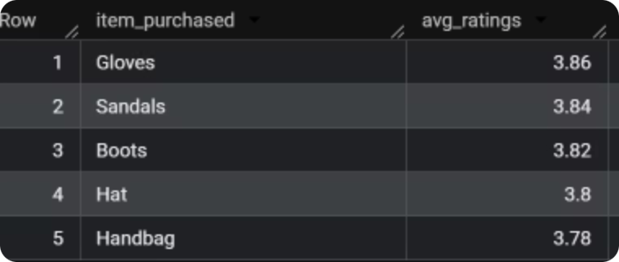
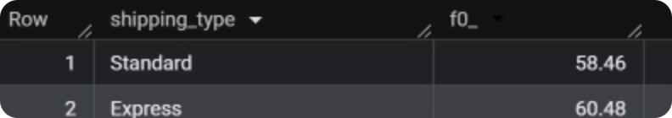
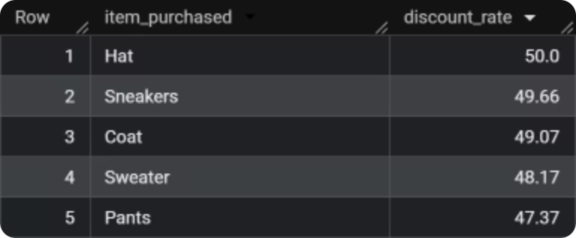
SQL Analysis: Products & Shipping
Standard vs Express Shipping
Top 5 Products by Rating
Top 5 Discount-Dependent Products

Slide 7
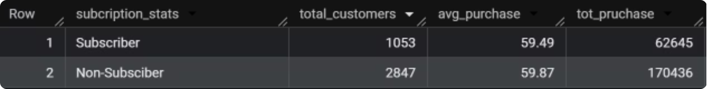
SQL Analysis: Subscribers & Segments
Subscribers vs Non-Subscribers
Compared average spend & total revenue
Customer Segmentation
New · Returning · Loyal — based on purchase history

Slide 8
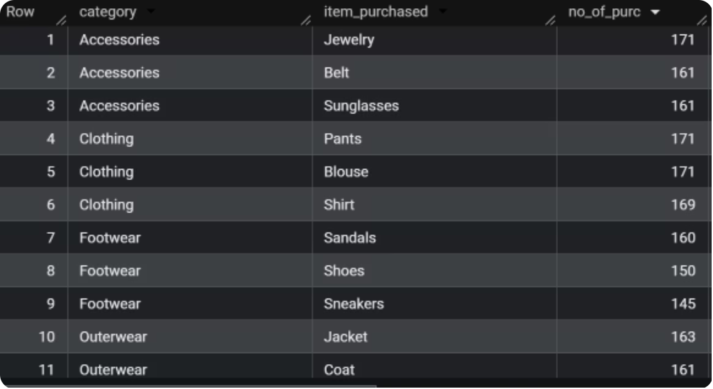
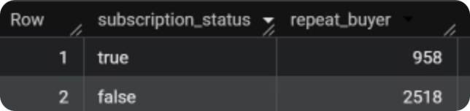
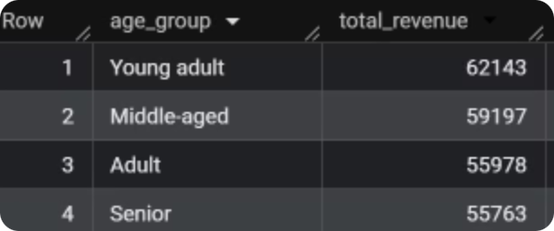
SQL Analysis: Categories, Repeat Buyers & Age
Repeat Buyers & Subscriptions
Revenue by Age Group
Customers with 5+ purchases more likely to subscribe
Top 3 Products per Category

Slide 9
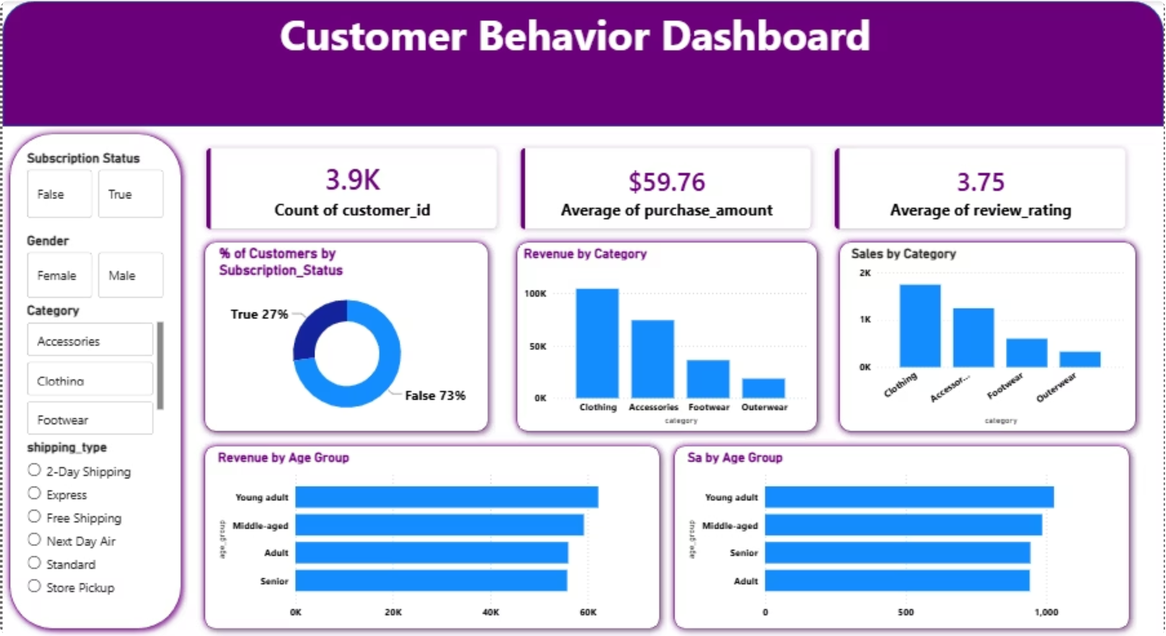
PowerBI Dashboard
An interactive dashboard built to present all key insights visually — enabling stakeholders to explore revenue, segments, and product performance at a glance.

Slide 10





Business Recommendations
Boost Subscriptions
Loyalty Program
Review Discount Policy
Promote exclusive subscriber benefits
Reward repeat buyers to grow loyal segment
Balance sales boosts with margin control
Targeted Marketing
Product Positioning
Focus on high-revenue age groups & express shipping users
Highlight top-rated & best-selling products in campaigns

